Slide 1


Wine Quality Analysis using machine learning and data science
Devanshi Nigam

Slide 2
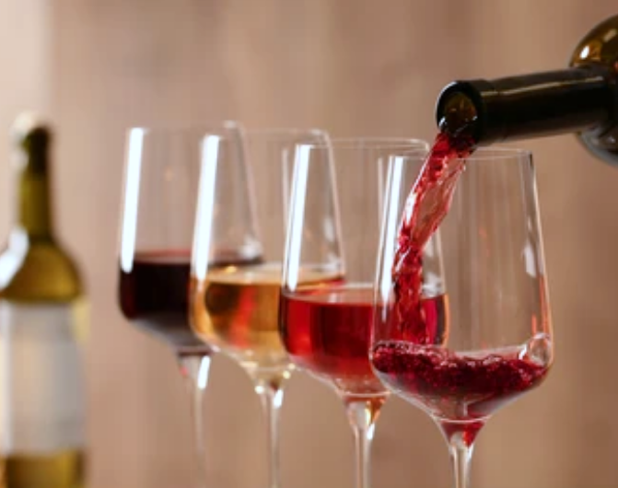
Content
Objective
Data Description
Data Analysis
Steps Undertaken
Model Description
Overview

Slide 3
OBJECTIVE
The main objective is to predict the quality of wine and understand which features are the most indicative of a good quality wine using machine learning through Python programming language.
A large dataset with 1500+ entries each with 12 attributes are considered.
This is a classification and regression problem analysed using machine learning algorithms.
Output obtained is further checked for correctness and model will be optimised accordingly.

Slide 4

Data Description

Slide 5
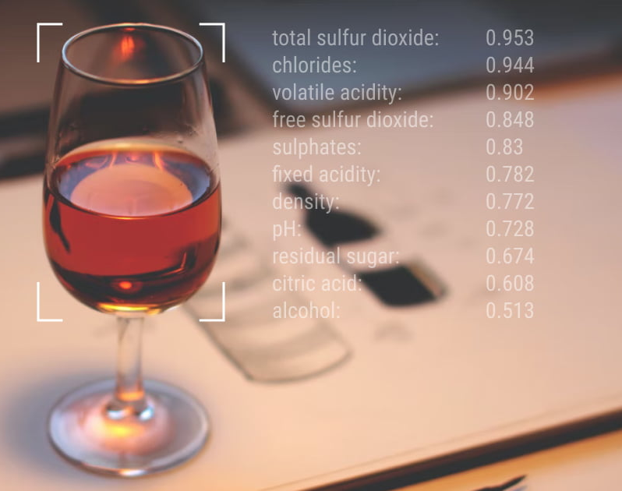
Attributes for Wine Analysis
Fixed acidity
Volatile acidity
Citric acid
Residual sugar
Chlorides
Free sulfur dioxide
Total sulfur dioxide
Density
pH
Sulphates
Alcohol
Quality

Slide 6
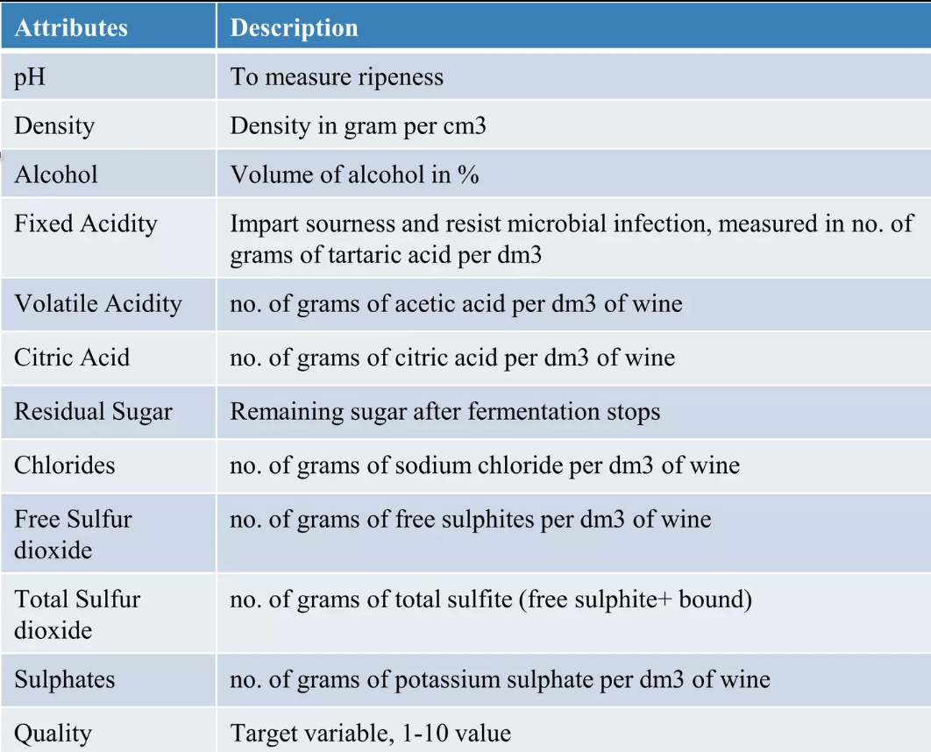

Slide 7
Histogram of different Attributes

Slide 8
Data Analysis

Slide 9
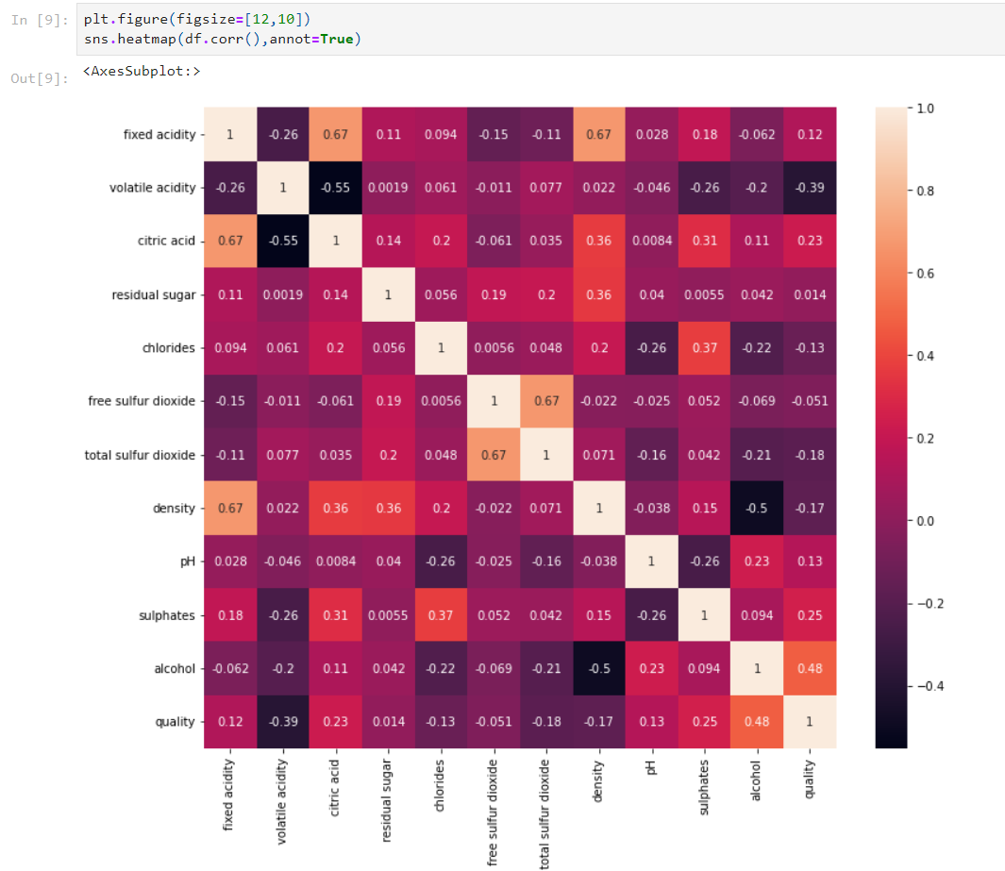
Correlation between the attributes

Slide 10
Some Insights
The most important feature among all the other attributes is Alcohol.
Higher concentration of wine leads to better quality of wine and lower density of wine.
On the other hand volatile acidity contributes to acidity of wine and have a negative correlation to wine quality.

Slide 11
Steps undertaken

Slide 12
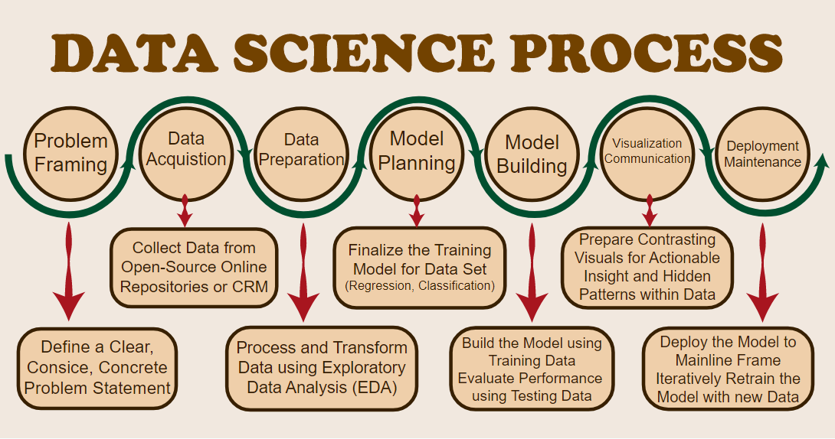

Slide 13
Model Description

Slide 14
Machine Learning Algorithms

Slide 16
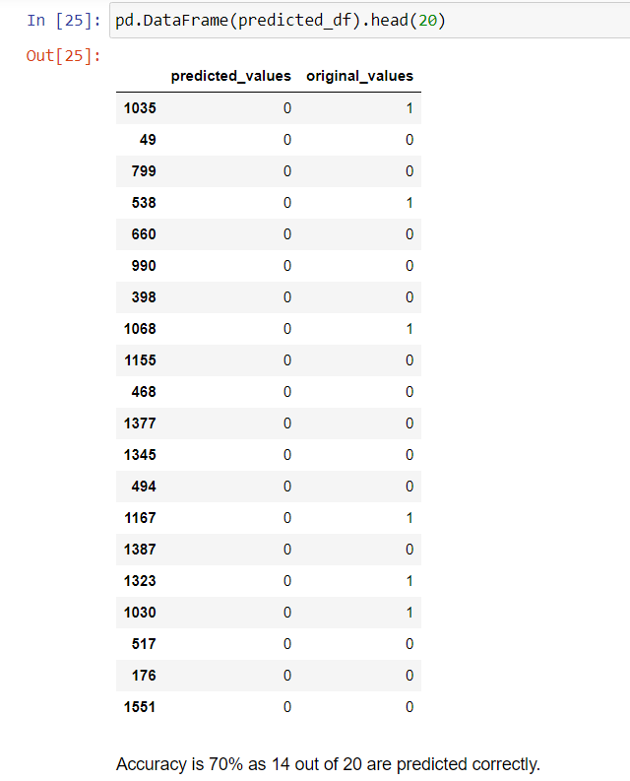
Result :

Slide 17
Overview

Slide 18
Overview
For this project, I used provided Red Wine Quality dataset to build ML classification models to predict whether a particular red wine is “good quality” or not.
Each wine in this dataset is given a “quality” score between 0 and 10. For the purpose of this project, I converted the output to a binary output where each wine is either “good quality” (a score of 7 or higher) or not (a score below 7).
Made a ML model which can analyse the quality of any wine using different machine learning techniques.
Result can be used by wine manufacturers to improve the quality of future wines.
Result can be used by customers for wine selection.

Slide 19
References
Gupta Y., “Selection of important features and predicting wine quality using machine learning techniques” Procedia Comput. Sci., vol. 125, 305–312, 2018.
E.Summary, W.P.Monitoring, W.Quality, W.Safety, W.Complexity, “Wine Analysis: from ‘Grape to Glass’ An analytical testing digest of the wine manufacturing process”,2016.
P.Model,L.Regression,R.Studio, “Building and Evaluating a Predictive model with Linear Regression in RapidMiner Studio’’,2018.

Slide 20
THANK YOU
Devanshi Nigam

